Slide 1


Team Members
Profile Matcher
WEB MINING
BIA-660
Archana Kalburgi
CWID: 10469491 CWID: 10458450
Shardul Shinde
Darpan Shah
CWID: 10467242 CWID: 10466451
Smit Gor

Slide 2

Introduction
Applying for internships/jobs
Time Consuming
Ineffective tracking/managing
Goal:
Expedites the Process
Generates match percentage

Slide 3
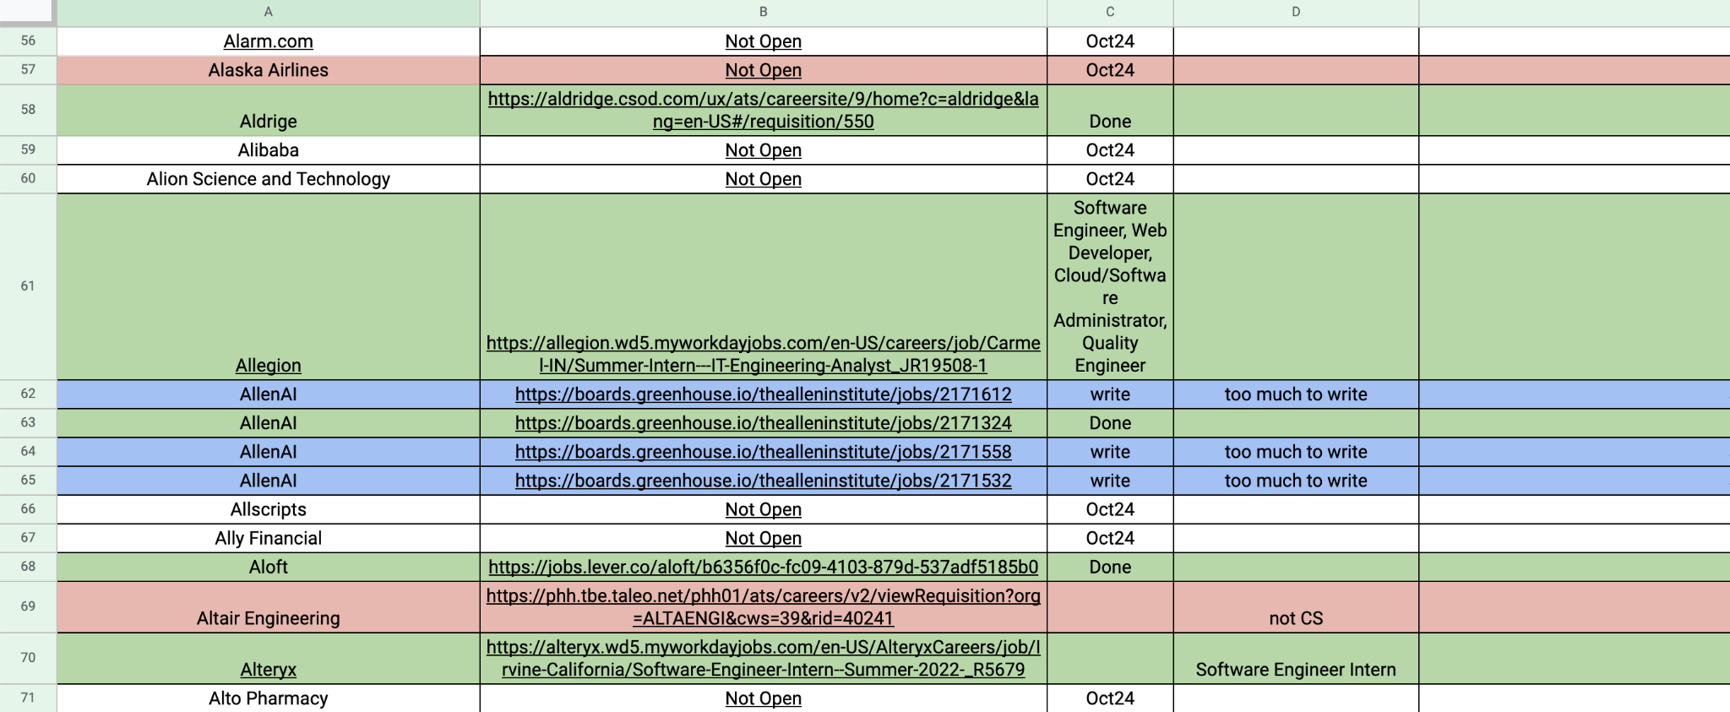
Notes:
By shardul

Slide 4
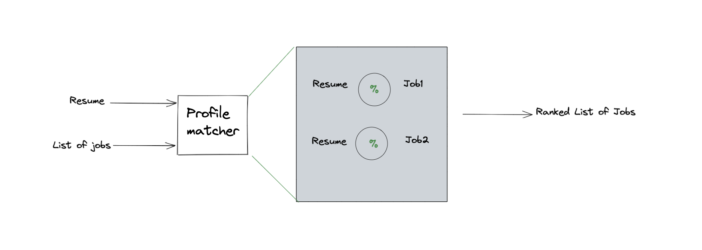
High Level Architecture

Slide 5
Profile Matcher
Initial Analysis
Datasets
EDA Analysis
Pre
Processing
Training Model
Feature Engineering &
Ranking

Slide 6
Initial Analysis
Keyword matching
Cosine similarity
Resume: Technical Sentence
Job: Qualification Sentence
=> Finds similarity score
Resume: Technical skills
Job: Qualification
CountVectorizer
Transform text into vector
=> on the basis of the frequency count of the words.
TFiDF
Transform text into vector
=> on the basis term frequencies and inverse document frequencies
Notes:
How do we do this % matching ?
Approaches we explored

Slide 7
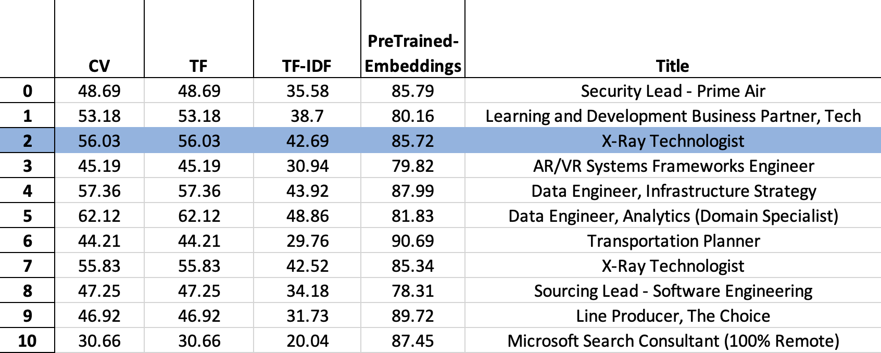
Notes:
This is without any preprocessing

Slide 8
Profile Matcher
Initial Analysis
Datasets
EDA Analysis
Pre
Processing
Training Model
Feature Engineering &
Ranking

Slide 9
Scrapping
LinkedinScraper
Filters
Optimize QueryOptions
Tika Parser
Notes:
By Smit
Talk more about LinkedIn Scraper
Tell the approach
How much data did we pull?
Talk about
Resume Data set
We use Tika Parser for reading this dataset
Ref: the colab file to add information about tika if you want

Slide 10
Job Dataset Description
Title
Company
Location
The scrapped dataset has the information about details of job openings from Linkedin. It consists of 3k rows and 8 columns.
Date
Link
Apply Link
Description
Seniority
Level
Notes:
By Smit
Talk more about LinkedIn Scraper
Tell the approach
How much data did we pull?
Talk about
Resume Data set
We use Tika Parser for reading this dataset
Ref: the colab file to add information about tika if you want

Slide 11
Profile Matcher
Initial Analysis
Datasets
EDA Analysis
Pre
Processing
Training Model
Feature Engineering &
Ranking

Slide 12
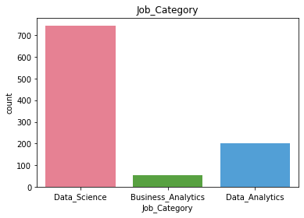
EDA Analysis
Notes:
By Darpan

Slide 13
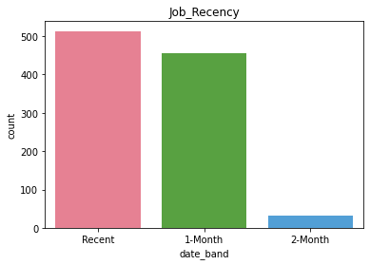
EDA Analysis

Slide 14
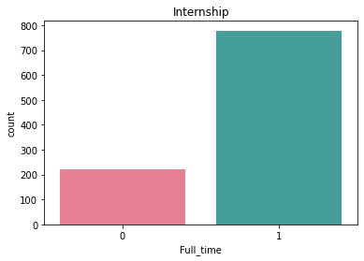
EDA Analysis

Slide 15

EDA Analysis
Notes:
By Darpan

Slide 16
Profile Matcher
Initial Analysis
Datasets
EDA Analysis
Pre
Processing
Training Model
Feature Engineering &
Ranking

Slide 17
Pre-processing Data
Punctuations
URLs and Email Id
Clean Data
Stop words
Lower and Lemmatize
Notes:
By Smit
This should come after EDA analysis

Slide 18
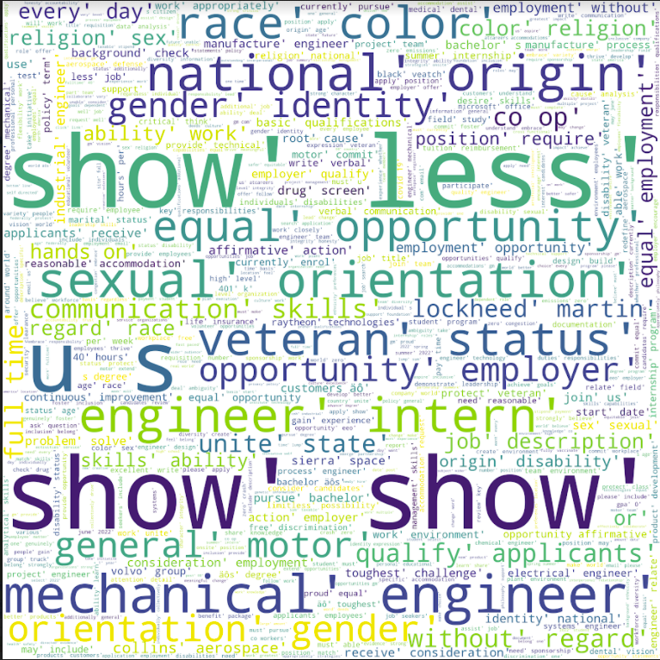
After Pre-processing

Slide 19
Profile Matcher
Initial Analysis
Datasets
EDA Analysis
Pre
Processing
Training Model
Feature Engineering &
Ranking

Slide 20
Word2Vec Embeddings
Preprocessing Additions
Lower case
Removed punctuation
Stopwords removal
Email address and web address removal
Lemmatization
Remove tokens which are digits
Remove all non-ascii characters e.g ‚äôs
Tokenize each document into a list of unigrams
only unigrams with 2 or more characters are taken
Steps Involved:
Pre-processing Data
Train Model
Test Model ( Visualize Models )
Save Model
Training Parameters:
PreProcessing Step
min_count: 1 { 5, 2, 1}
window : 5 { 5, 10}
size: 300 { 100, 150, 300}
Notes:
By Archana
Min_count - 5 , 2 , 1 ( nltk )
Window: 5 , 10
Size : Dimension 100, 150, 300
Convert to Lower Case
remove email doc = re.sub(r'\S*@\S*\s?', '', doc, flags=re.MULTILINE)
remove web addresses doc = re.sub(r'http\S+', '', doc, flags=re.MULTILINE)
Remove tokens which are digits doc = re.sub(r'\b\d+\b', '', doc, flags=re.MULTILINE)
Remove website addresses "www." doc = re.sub(r'www\.\S+', '', doc, flags=re.MULTILINE)
Remove all non-ascii characters e.g ‚äôs doc = re.sub(r'[^\u0000-\u007F]+', '', doc, flags=re.MULTILINE)
Replace punctuations with space
Tokenize each document into a list of unigrams
only unigrams with 2 or more characters are taken
Stop words removal
Check if the word is made up of english letters and is not alpha-numeric
strip punctuations and leading/trailing spaces from unigrams
WordNetLemmatizer to lemmatize token
Remove alphanumeric tokens like gd17, 11693b3

Slide 21
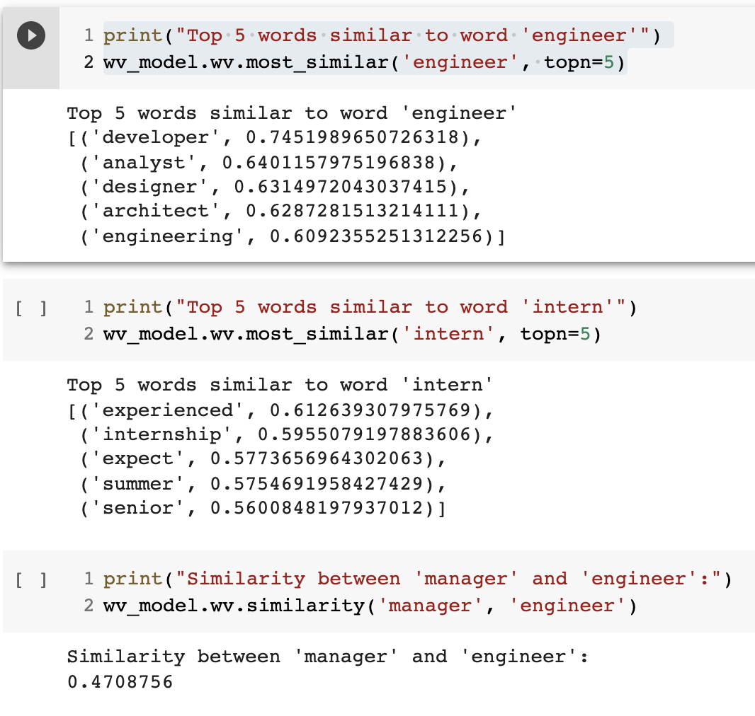
Word2Vec
Performance
Most Similar Words -->
Notes:
By Archana

Slide 22
Visualization: Word2Vec (300 Dimension to 2D)
Vocabulary: 14436 words
Resume Sections
'experience',
'level',
'skill',
'location',
'title',
'Company',
Level we are interested in:
'intern'

Slide 23
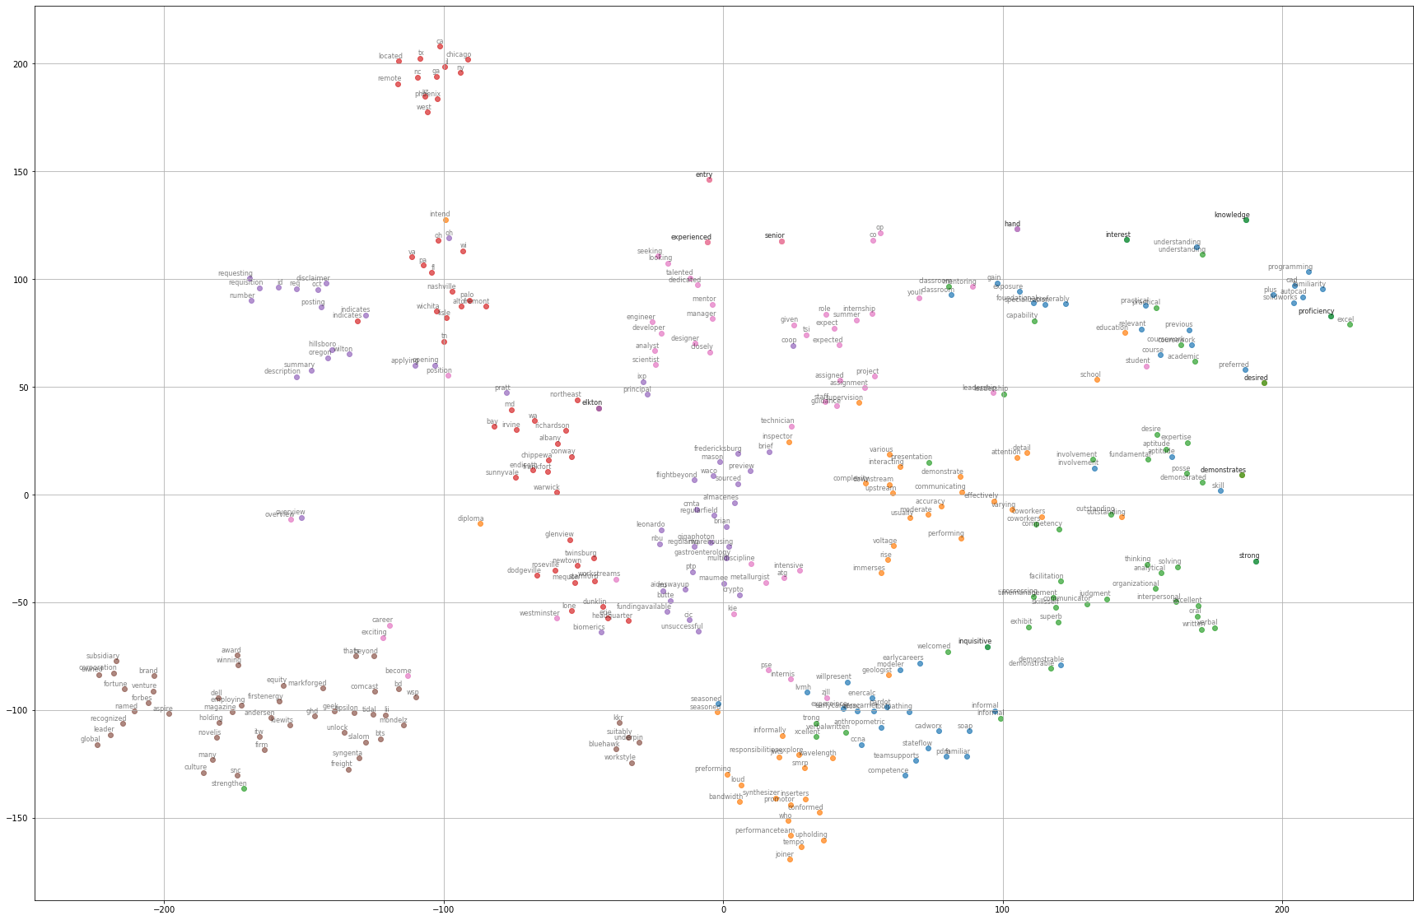
Notes:
By Archana

Slide 24
Profile Matcher
Initial Analysis
Datasets
EDA Analysis
Pre
Processing
Training Model
Feature Engineering &
Ranking

Slide 25
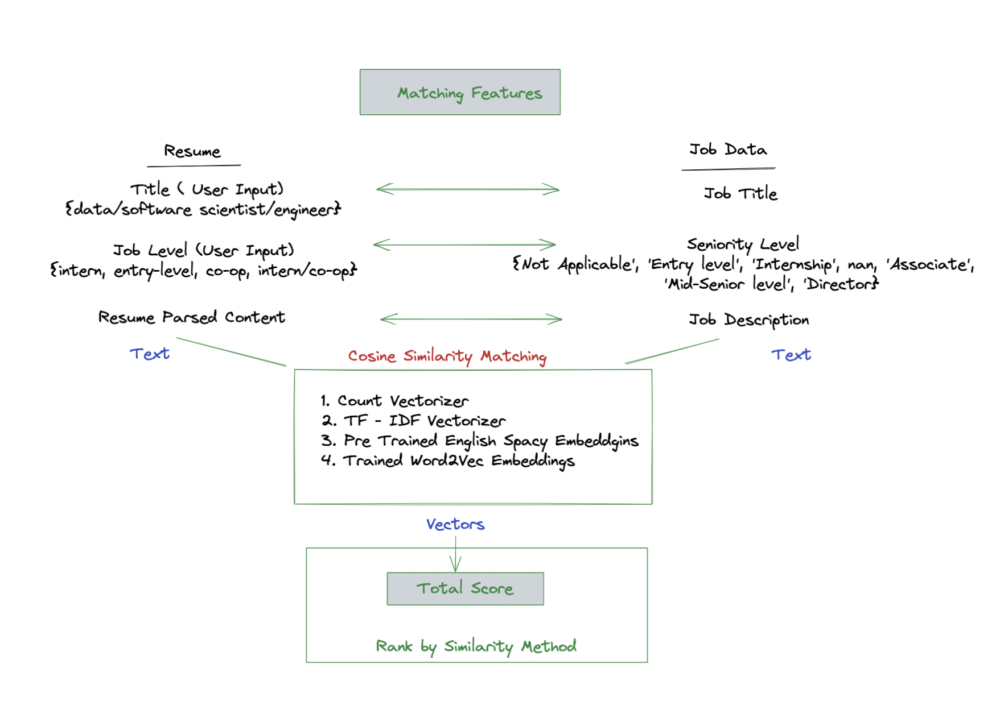
Feature Engineering for Profile Matcher
Notes:
By Archana
Explain how total score is build

Slide 26
Initial Results Recap
Notes:
This is without any preprocessing

Slide 27
Results of Similarities Compared
Index | CV | TF | TF-IDF | PreTrained-Embeddings | CustomTrained-Embeddings | MatchedLevel | MatchedTitle | Title | TotalScore
3 | 27.32 | 27.32 | 16.31 | 89.95 | 70.01 | 100 | 100 | Data Science Intern | 270.01
4 | 9.54 | 9.54 | 5.33 | 93.4 | 47.92 | 100 | 100 | Information Technology / Software Engineer - 2022 Summer Internship | 247.92
5 | 11.57 | 11.57 | 6.36 | 92.76 | 65.29 | 100 | 0 | Design Engineer, Internship 1 | 165.29
0 | 36.15 | 36.15 | 24.29 | 83.51 | 72.87 | 0 | 100 | Data Engineer, Analytics (Domain Specialist) | 172.87
1 | 9.32 | 9.32 | 5.19 | 86.21 | 62.76 | 0 | 100 | Senior Software Engineer | 162.76
2 | 4.8 | 4.8 | 2.5 | 88.13 | 17.18 | 0 | 0 | Microbiology Supervisor | 17.18
This is ranked by CustomTrained Model.
Currently our results ranking can be configured depending on the input vectorization me.

Slide 28
Future Scope
Improving Custom Training with more data
Skills matching section wise
Resume: skills, courses sections
Job: qualifications, preferred skills sections
Professional title matching ( regex based currently; we can further build title embeddings)
Embeddings Phrases (* Bigrams / n-grams)
Notes:
By Archana

Slide 29

Questions ?

